Slide 1
IDENTIFICATION OF BRAIN TUMOR FROM MRI IMAGES USING
SUPPORT VECTOR MACHINE
Under the Guidance of
Dr. N.J. NALINI,
ASSISTANT PROFESSOR
DEPT OF COMP. SCI. AND ENGG
Project Members
Name Reg. No.
C. ALEXANDAR - 141080903
S. SELVENDIRAN - 141080967
G. VIJAYARAJ - 141080981

Slide 2
ABSTRACT
Medical image processing is a challenging field now a days and also to process the MRI images because it is the scan of the soft tissues.
MRI (Magnetic Resonance Imaging) play an important role in brain tumour for analysis, diagnosis and treatment planning.
MRI is mainly used to get images of the human body cancerous tissues because of its high resolution and better quality images compared with other imaging techniques.
The process of identifying brain tumor through MRI images includes pre-processing, segmentation, feature extraction and classification.

Slide 3
INTRODUCTION
Abnormal growth of tissues in the brain which affect proper brain function is consider as brain tumor.
Brain tumor can primary and metastatic, also can be benign or malignant
Primary brain tumors include any tumor that start within the brain also it affect the membrane around the brain, nerves or glands.
Metastatic brain tumor is a cancer that can spread from elsewhere in the body to any part of the brain.

Slide 4
OBJECTIVES
This work describes the strategy to identify the types of tumour affected brain from given MRI brain images.
The goal of Medical Image processing is to identify accurate and meaningful information using images with minimum error possible.
Magnetic Resonance Imaging (MRI) provides greater contrast images of the brain and cancerous tissue.

Slide 5
TYPES OF PRIMARY BRAIN TUMORS
Serial No. | Benign | Malignant
1. | Non-Cancerous | Cancerous
2. | Slow-growing | Fast-growing and Aggressive
3. | Do not spread to surrounding tissue | Can invade nearby tissue and also are more likely to recur after treatment

Slide 6
LITERATURE REVIEW
SI.NO | TITLE | AUTHORS | TECHNIQUES APPLIED
1. | Detection of Possibility of Brain Tumor Using Image Segmentation | Swati Ghare, Nikita Gaikwad et al ,2015 | Segmentation using Fuzzy C means
2. | Image Analysis for MRI Based Brain Tumor Detection and Feature Extraction Using Biologically Inspired BWT and SVM | Nilesh Bhaskarrao Bahadure, Arun Kumar Ray et al,2017 | Segmentation using Berkeley wavelet transform and classification using support vector machine.
3. | Brain tumor MRI image segmentation and detection in image processing | Rohini Paul Joseph, C. Senthil Singh, 2014 | K-means clustering algorithm followed by morphological filtering.

Slide 7
4. | Brain tumor extraction from MRI images using MATLAB | Rajesh C. Patil and Dr.A.S. Bhalchandra et al – 2012 | Meyer’s flooding watershed algorithm and also morphological operation
5. | Brain tumor image segmentation using MATLAB | D.Dhilip Kumar, S.Vandhana et al ,2015 | Segmentation through threshold and classification using SVM
6. | Analysis and Comparison of Brain Tumor Detection and Extraction Techniques from MRI Images | Geetika Gupta, Rupinder Kaur,2014 | Segmentations cellular neural network, watershed and edge detection, k-means clustering
7. | A Classifier to Detect Tumor Disease in MRI Brain Images | Amer Al-Badarnech, Hassan Najadat, Ali M. Alraziqi, | Neural Network (NN) and k- Nearest Neighbor(k-NN) on classification has been achieved 100% accuracy using k-NN and 98.92% using NN.

Slide 8
METHODOLOGY
The major steps to identify a tumor affected brain from MRI image are given as follows
Give MRI image of brain as input.
2) Convert it into grayscale.
3) Compute segmentation using thresholding.
4) Feature extraction using GLCM (Gray Level Co-occurrence Matrix).
5) Identification of tumor affected brain using SVM (Support Vector Machine)

Slide 9
Input MRI Image
WORK FLOW DIAGRAM
Pre - processing
Segmentation of Images
Training Images
Test Images
Feature Extraction
(GLCM)
Feature Extraction
(GDLCM)
Testing data
SVM
Classifier
Trained data
Brain Tumor Identification
(Non - Cancerous)
Benign
Malignant
(Cancerous)

Slide 10
DESIGN MODULES
The following are the modules designed for the proposed system.
Pre – processing
Segmentation
Feature extraction
Classification

Slide 11
MODULE DESCRIPTION
PRE-PROCESSING
The main goal of the pre-processing is to enhance the visual appearance of images and improve the manipulation of datasets.
Gray Scale Conversion
The image acquired is in RGB color. It is converted into gray scale because it carries only the intensity information which is easy to process instead of processing three components R (Red), G (Green), B (Blue). For many applications of image processing, colour information doesn't help us to identify important edges or other features.
b) Resizing Image
Image resizing is necessary when you need to increase or decrease the total number of pixels. The datasets consist of MRI brain tumor images, each of whose size is converted into 256x256.

Slide 12
SEGMENTATION
In this work the segmentation of MRI brain image is performed using Otsu’s thresholding.
Otsu’s Thresholding Method
Thresholding is the simplest method of image segmentation. From a grayscale image, thresholding can be used to create binary image (black and white image).
It computes a global threshold that can be used to convert an intensity image to a binary image. The Otsu's method, which chooses the threshold to minimize the intraclass variance of the black and white pixels.

Slide 13
FEATURE EXTRACTION
Feature extraction is a special form of dimensional reduction. When the input data to an algorithm is too large to be processed and it is suspected to be very redundant then the input data will be transformed into a reduced representation set of features (also named a feature vector).
Features of an image are the properties that completely describe the image.
GLCM (GrayLevel Co-occurrence Matrix) features
The co-occurrence matrix and texture features are the most popular second order statistical features today.
The important texture features for classifying the image into water body and non-water body are Energy (E), Entropy (Ent), Contrast (Con), Inverse Difference Moment (IDM) and Directional Moment (DM).

Slide 14
INTENSITY-BASED FEATURES (IBF)
Intensity pattern in tumor region is modeled using histograms of target image and range filtered image.
Intensity-statistical parameters namely: mean intensity, standard deviation, skewness, and kurtosis from the histogram of an image within the tumor segment are calculated.

Slide 15
CLASSIFICATION
Image classification analyzes the numerical properties of various image features and organizes data into categories.
Classification algorithms typically employ two phases of processing: training and testing.
In the initial training phase, characteristic properties of typical image features are isolated and, based on these, a unique description of each classification category, i.e. training class, is created.
In the subsequent testing phase, these feature-space partitions are used to classify image features.

Slide 16
SUPPORT VECTOR MACHINE
SVM algorithm is a binary classifier based on supervised learning which gives better result than other classifiers.
SVM classifies between two classes by constructing a hyperplane in high-dimensional feature space which can be used for classification.
SVM is a classification algorithm, which is based on different kernel methods. It classifies the segmented object with GLCM features which gives the best results.
It mainly gives better results for pattern classification and non-linear regression. It maps input space into higher dimensional feature space.
In this work support vector machines are chosen for identifying the tumor affected brain. The brain tumor is recognized using segmentation and the GLCM features are extracted for classification.

Slide 17
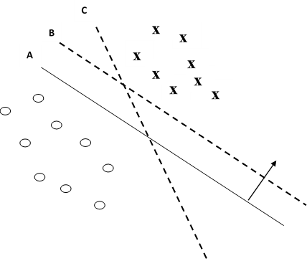
Support Vector Machine
In the above figure, there are two classes ‘x’ and ‘o’ and there are 4 hyperplanes namely A, B and C.
Hyperplane A provides the best separation between the classes, because the normal distance of any of the data points is the largest, so it represents the maximum margin of separation.

Slide 18
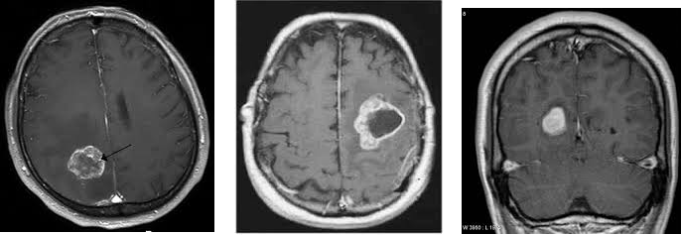
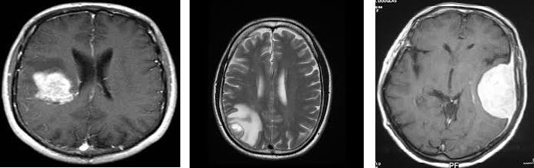
Sample images of Benign tumor
Sample images of Malignant tumor

Slide 19
DATABASE COLLECTED
Harvard Medical School (URL: http://med.harvard.edu/AANLIB/)
OASIS dataset (URL: http://www.oasis-brains.org/)
ADNI dataset (URL: http://adni.loni.ucla.edu/).

Slide 20
CONCLUSION
SUMMARY OF WORK
In this work developed a novel approach for identification of tumor affected brain. The work involves using SVM with Linear kernel function to identify the input images which is MRI Brain tumor image belongs to benign and malignant classification.
The proposed work gives more accurate result than the other research work. The method obtained 90.0% classification accuracy on the T2-weighted brain MRI image datasets.
FUTURE ENHANCEMENT
For future work, to get better accuracy rate and less error rate a Hybrid SVM algorithm is to be proposed.
The proposed algorithm can also be extended to produce such accuracy in other modality images such as CT, PET and ultrasound.

